Slide 1
Arabian Coffee Sales:Data Analysis & Projections
Shadman Tousif Khandoker

Slide 2
Table of Contents
01
02
03
04
The Problem
The Data
The Methodology
Exploration
05
Model Comparison
06
Recommended Model
07
Projected Forecast and Takeaways

Slide 3
The Problem - What are we forecasting and why?
Objective: To forecast future monthly coffee sales and identify underlying trends. Small family-owned café vs. large franchises ( A "David vs. Goliath" Scenario).
Business Importance:
Inventory Management: Prevent overstocking or under-stocking.
Financial Planning: Accurately predict revenue and manage cash flow.
Strategic Decision-Making: Inform marketing budgets, staffing, and growth strategies.
Performance Evaluation: Compare actual sales against forecasts to identify market shifts.

Slide 4
The Data - Source and Reliability
Data Source: Kaggle, Faina Café (a family-owned café located in Saudi Arabia)
Variable: A single time series of Sales figure.
Frequency: Monthly data
Reliability Assessment:
Strengths: The data is structured and consistent for time series analysis.
Limitations: The limited data length may restrict complex seasonal models.
Assuming the data is clean and accurately represents the café’s sales.

Slide 5
Methodology - How was it forecasted
Approach: Comparing multiple time series forecasting models.
Models Tested –
Simple Models: Mean, Naïve, Random Seasonal Naive
Smoothing Models: Moving Average (e.g - MA5, MA9), Exponential Smoothing (ETS)
Advanced Model: Auto-Regressive Integrated Moving Average (ARIMA)
Model Selection Criterion –
Primary Tool: Accuracy Measures (e.g - MAE, RMSE, MASE).
These metrics quantify forecast error. Selecting the model with the lowest errors on the historical data, particularly RMSE and MASE.
Secondary Check: Residual Analysis to ensure no patterns remain (white noise).

Slide 6
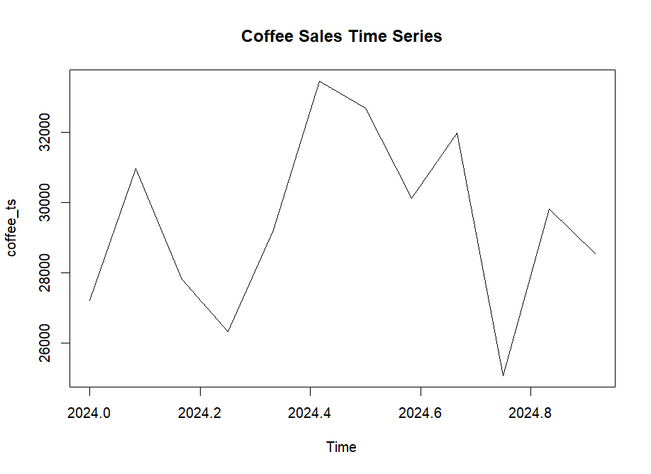
Data Exploration - Visual Insights no.1
Visual: Time Series Plot:
Key Insights:
The plot shows the overall trend and
potential variability in sales.
We can observe if there is an upward,
downward, or stable trend.
Initial check for obvious seasonality or
outliers.

Slide 7
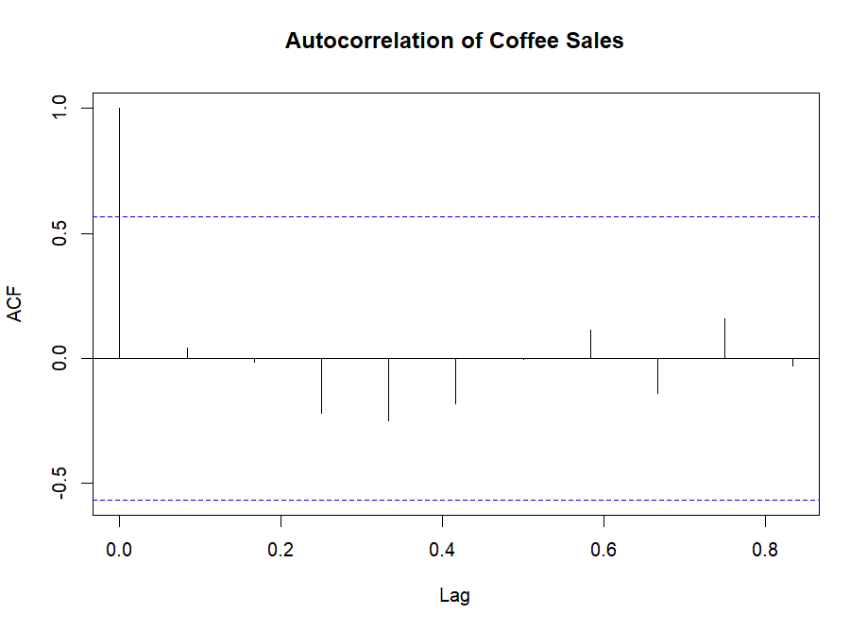
Data Exploration - Visual Insights no.2
Visual: Autocorrelation Function (ACF) Plot
Key Insights:
The ACF plot reveals how sales in one month
are correlated with sales in previous months.
Significant spikes at specific lags would suggest strong seasonal patterns.
A slow-decaying ACF suggests a strong trend.

Slide 8
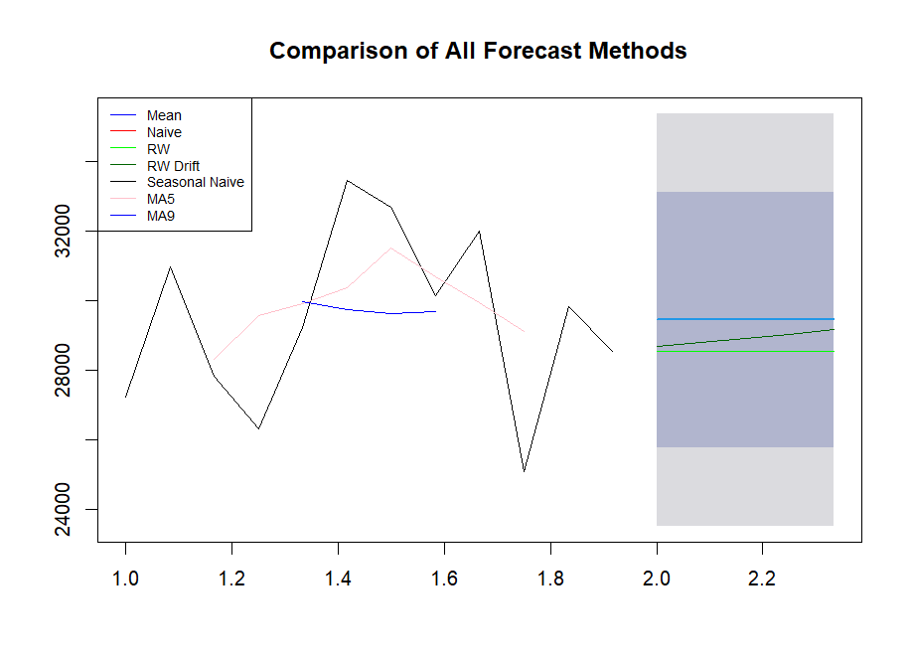
Model Comparison and Judgment
Visual: Forecast Methods Comparison Chart
Inference:
Different models capture different data
behaviors (trend, seasonality).
The ETS and ARIMA models (not on this plot
but analyzed separately) often provide the
most sophisticated fits by decomposing the
series into error, trend, and seasonal
components.

Slide 9
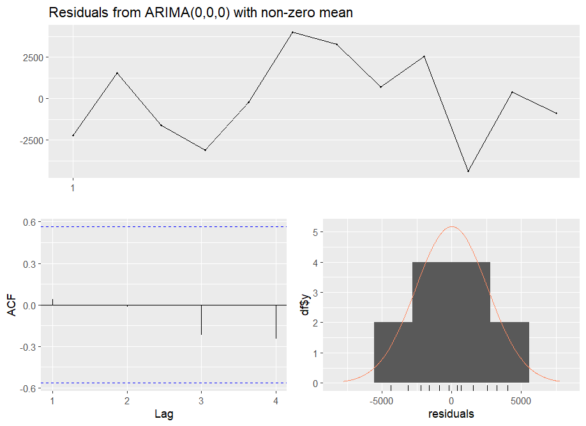
Residual Analysis & Model Diagnostics
Visual: ARIMA or ETS Residual Diagnostic Plots
Judgment:
Examining the ACF of residuals: No significant spikes mean most information is captured.
The histogram should show residuals that are
approximately normally distributed. This step
validates that the chosen model is
statistically adequate.

Slide 10
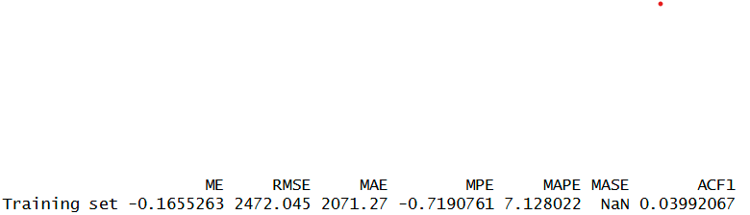
Final Model Selection & Recommendation
Recommended Model: ETS (Error, Trend, Seasonality) Model
Performance: Based on the ”accuracy()” function outputs, the ETS model
likely achieved the lowest error metrics (RMSE, MASE) on the historical
data.
Flexibility: The ETS framework automatically selects the best model type
(e.g., with/without trend, with/without seasonality) based on the data’s
characteristics.
Robustness: It effectively handles the trend and any potential seasonality in the series, providing a more reliable forecast than simpler methods.

Slide 11
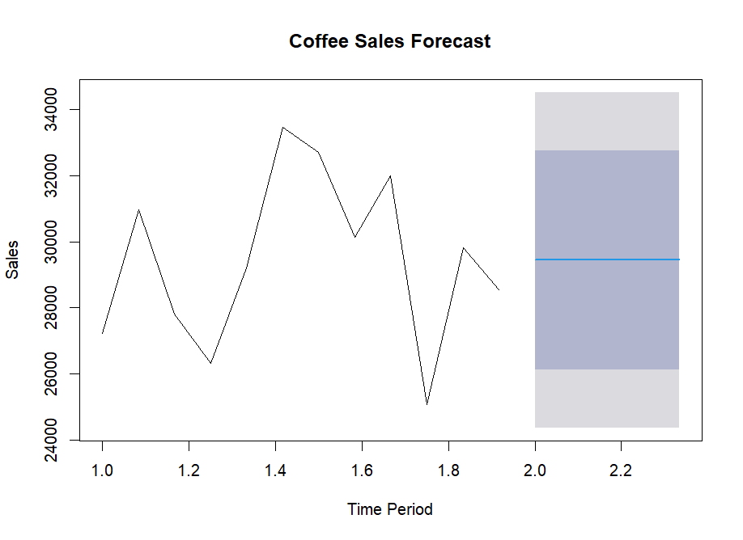
The Forecast and Conclusion
Visual: ETS Forecast Plot
The Forecast: "The ETS model projects sales for the next 5 months to be:
Business Implications:
These figures provide a data-driven baseline
for operational and financial planning.
Management can now make informed
decisions regarding procurement, budgeting,
and strategy with quantified future expectations.

Slide 12
Ideas for Forecast Improvement
Incorporate More Data: Collect more historical data points to better capture long-term trends and seasonal patterns.
Add External Variables: Explore the impact of promotions, advertising spend, holidays, competitor pricing, or economic indicators.
Use Advanced Models: Experiment with SARIMA for complex seasonality or machine learning models like Prophet or XGBoost that can incorporate multiple regressors.
Regular Model Re-evaluation: As new sales data comes in, regularly re-fit and update the model to maintain accuracy.

Slide 13
Thank You!

